Slide 1
Process of digestion in oesophagus and stomach
1

Slide 2
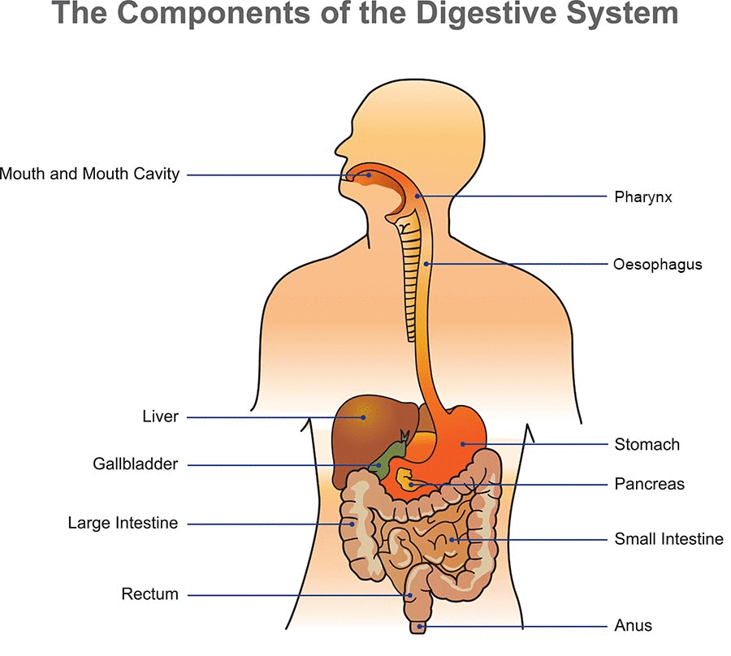
5/26/2020
TOPIC/COURSE CODE-NAME/FACULTY/DEPT/COLLEGE
3/10

Slide 3
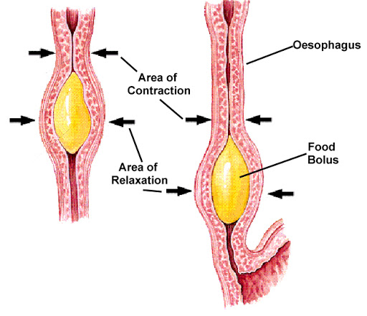
THE OESOPHAGUS
The oesophagus connects mouth to the stomach
Made up of muscles.
Muscles gently push food down to your stomach
A wave-like action called peristalsis

Slide 4
The Stomach
1.J-shaped bag made up of Muscles
2.Hold up to two litres of food at a time
3.Food stays in the stomach from a few minutes to a few hours depending on the type of food eaten.

Slide 5
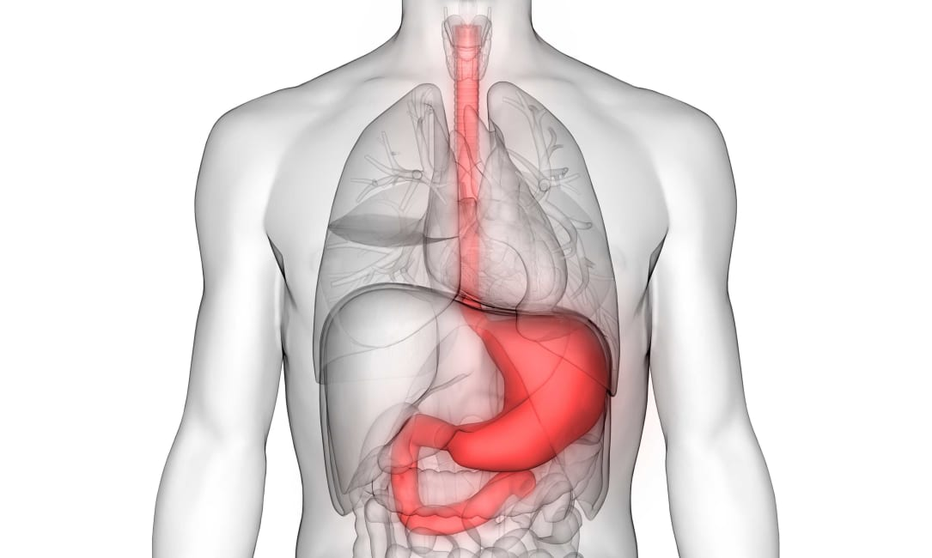
THE STOMACH
4.The inner lining of the stomach secretes mucous, hydrochloric acid and digestive juices.
5.The mucous protects the inner lining of the stomach.
6.The acid kills bacteria that enter along with food and also helps in digestion of proteins.
7.The stomach muscles squeeze and mix the food with digestive juices.
8.The digestive juices break down proteins
into simpler substances
9.food gets partly digested in the stomach

Slide 6
Mucus is a slimy substance secreted by the mucus membrane and glands in animals for lubrication and protection
5/26/2020
TOPIC/COURSE CODE-NAME/FACULTY/DEPT/COLLEGE

